Slide 1
Hobby Website Application
Nathan Jackson

Slide 2



Technologies
Front-End
HTML
Javascript
Bootstrap/CSS (Learned not Used)
Back-end
Spring
Java
Maven
Testing
J-Unit
Selenium
Mockito

Slide 3
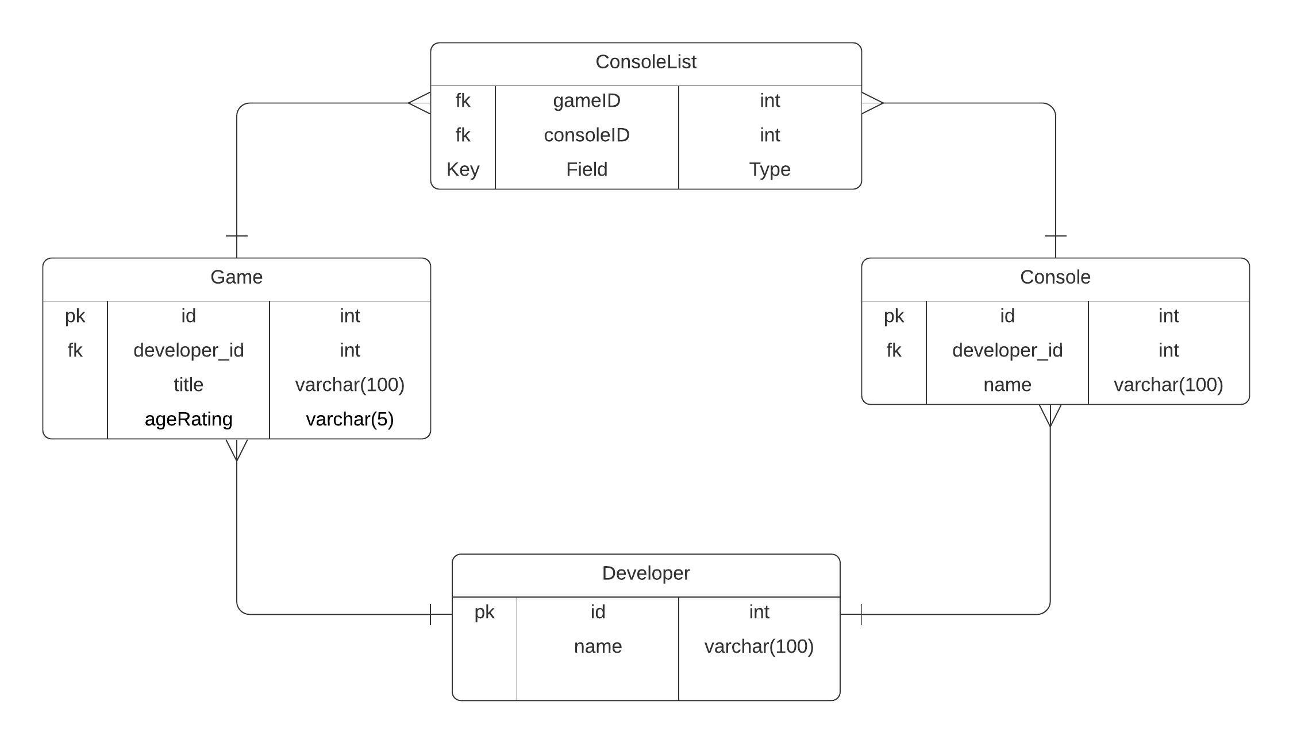
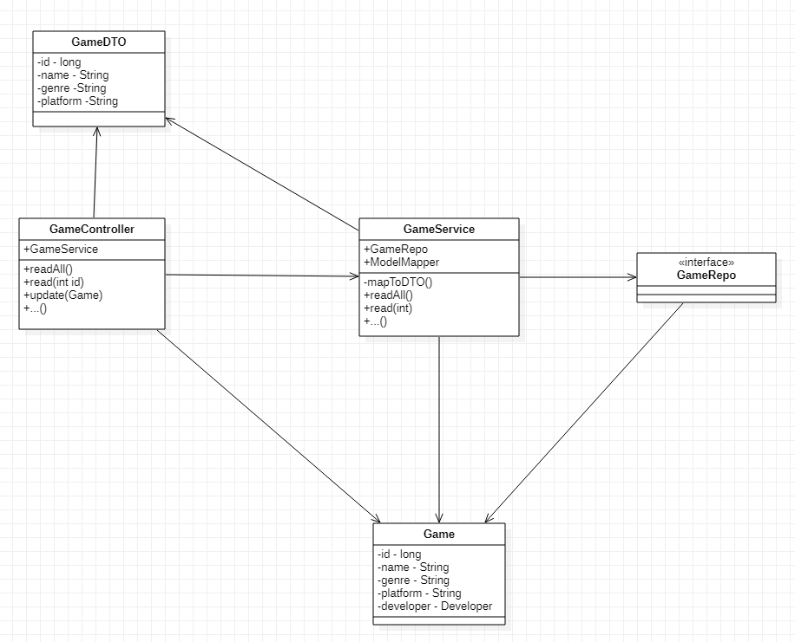
Initial Planning & Approach
Initial Plan was for 3 Entity system based on Games
Many-to-Many relationship between Console and Games
Repository Design pattern
Interaction between classes not modelled originally

Slide 4
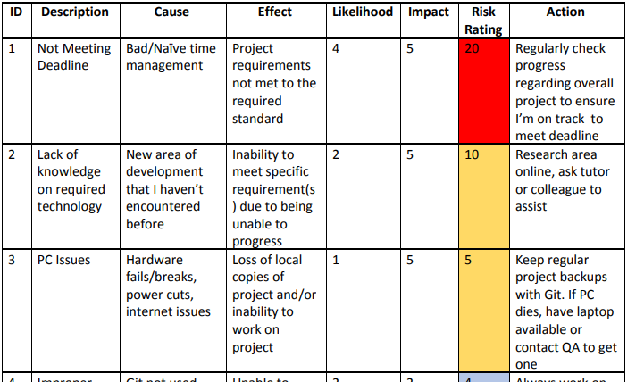
Risk Assessment
7 total risks
PC issues only risk to actualise
Was able to recover with Git

Slide 5
Goals
Main Goals:
Front-End that enables user full CRUD functionality
Back-end that processes data going to and from the DB
Database created on started of program
Thorough testing of both website and back-end
Stretch Goals:
Easy to use front-end
Feedback and data, output appropriately to web page
3 Entities linked in the database

Slide 6
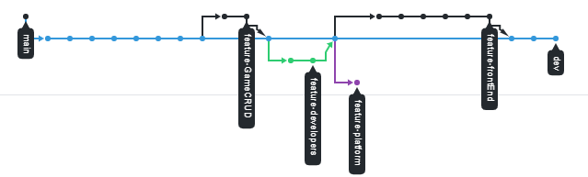
Version Control
Github used for version control
Branches used for each feature, platform entities in unfinished branch
Helped recover from PC reset

Slide 7
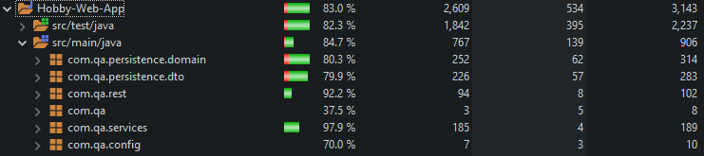
Testing
Back-end testing at 84.7% coverage
Domain and DTO equals method not fully tested
J-Unit used with Mockito for Controllers

Slide 8
Front-End Testing
Selenium used to test website functionality
Very inconsistent tests with clickable buttons sometimes not registering
All functionality tested for both pages

Slide 9
Demo

Slide 10
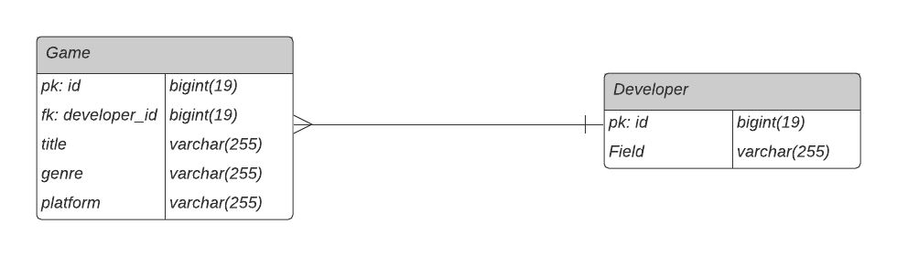
Review
What Got Done
Full CRUD functionality for 2 linked entities
Easy to use website for front-end
Linked front end to access and modify DB through back-end
What Got Left Out
Third Entity interaction
Front End split through forms
Complete Reliable Selenium Tests

Slide 11
Retrospective
What Went Well
All primary goals met in timely manner
Version control helped revert and backup when needed
Jira used to manage tasks well, linked with Git for smart commits
What Didn’t
Errors in build path occured at some point
Lack of thorough planning ahead of ERD
Testing plan wasn’t thought through too well

Slide 12
Conclusion
Generally Successful project
Big improvements in process over last project
More thorough planning for development and testing

